Slide 1
Type Checking
Dr. N. Kalyani
Professor, CSE

Slide 2
Type Checking
In principle, any check can be done dynamically, if the target code carries the type of an element along with the value of the element.
To do type checking a compiler needs to build a type system that can assign a type expression to each component of the source program, depending on the logical rules and perform type checking.
A sound type system eliminates the need for dynamic checking for type errors, because it allows us to determine statically that these errors cannot occur when the target program runs.
An implementation of a language is strongly typed if a compiler guarantees that the programs it accepts will run without type errors.
Besides their use for compiling, ideas from type checking have been used to improve the security of systems that allow software modules to be imported and executed.

Slide 3

1. Rules for Type Checking
Type checking can take any one of two forms: synthesis and inference.
Type synthesis builds up the type of an expression from the types of its subexpressions.
It requires names to be declared before they are used.
The type of E1 + E2 is defined in terms of the types of E1 and E2.
A typical rule for type synthesis has the form
Here, f and x denote expressions,
and s→ t denotes a function from s to t.

Slide 4

1. Rules for Type Checking
Type inference determines the type of a language construct from the way it is used.
Let null be a function that tests whether a list is empty. Then, from the usage null(x), we can tell that x must be a list.
The type of the elements of x is not known; all we know is that x must be a list of elements of some type that is presently unknown. Variables representing type expressions allow us to talk about unknown types.
A typical rule for type inference has the form

Slide 5
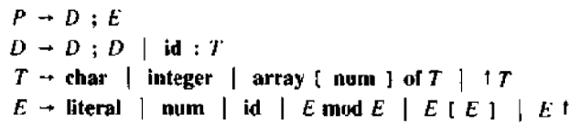
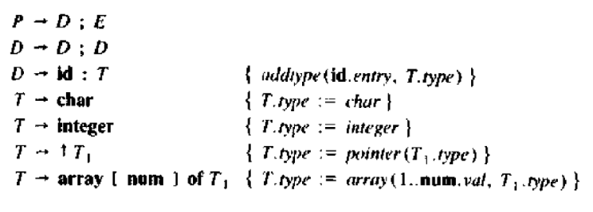

Type checking

Slide 6
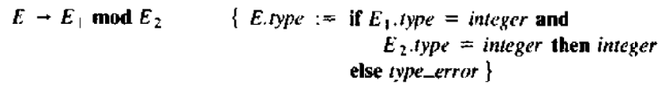
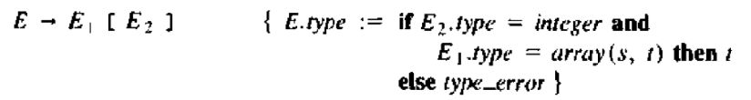

Type checking

Slide 7
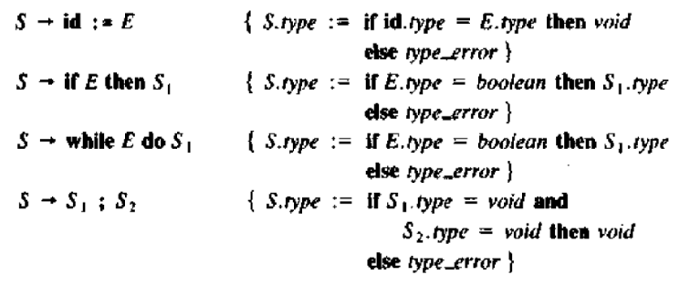

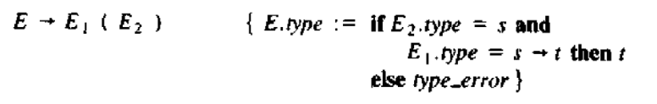
Type checking

Slide 8
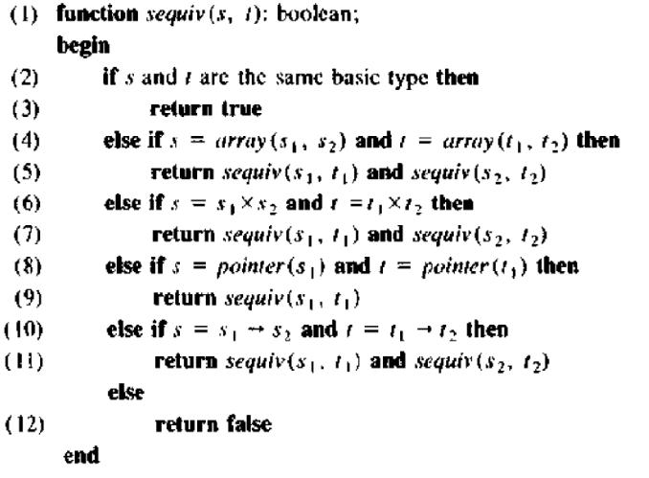
Type Equivalence

Slide 9

2. Type Conversions
Consider expressions like x + i, where x is of type float and i is of type integer. the compiler may need to convert one form to other.
Suppose that integers are converted to floats when necessary, using a unary operator ( float ) . For example, the integer 2 is converted to a float in the code for the expression 2*3.14:
Type synthesis will be illustrated by extending the scheme for translating expressions with a new attribute E.type, whose value is either integer or float. The rule associated with E → E1 + E2 builds on the pseudocode

Slide 10
2. Type Conversions
The increase in the number of types subject to conversion increases, the number of cases. The semantic actions becomes important with large numbers of types.
Type conversion rules vary from language to language.
Conversion from one type to another is said to be implicit if it is done automatically by the compiler.
Implicit type conversions, also called coercions, are limited in many languages to widening conversions.
Explicit conversions are also called casts.

Slide 11
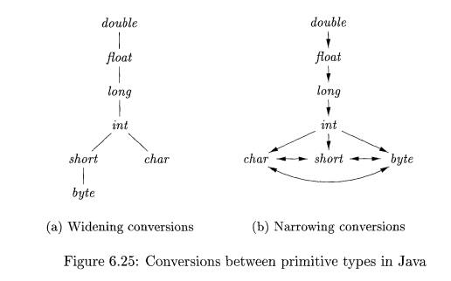
2. Type Conversions

Slide 12
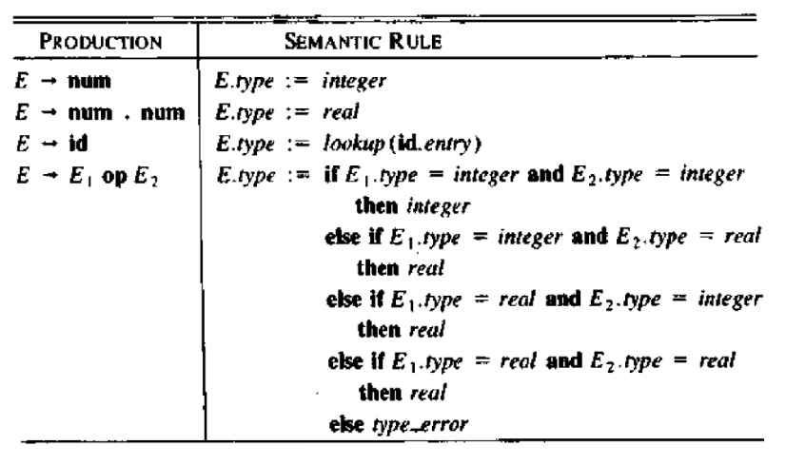
Rules for Type Coercion

Slide 13
2. Type Conversions
The semantic action for checking E → E1 + E2 uses two functions:
max(t1,t2) takes two types t1 and t2 and returns the maximum (or least upper bound) of the two types in the widening hierarchy. It declares an error if either t1 or t2 is not in the hierarchy.
widen(a, t, w) generates type conversions if needed to widen an address a of type t into a value of type w.
It returns a itself if t and w are the same type.
Otherwise, it generates an instruction to do the conversion and place the result in a temporary t, which is returned as the result.

Slide 14
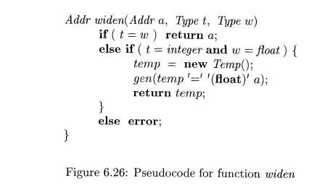
2. Type Conversions

Slide 15
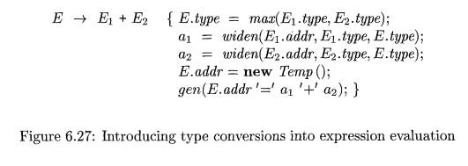
2. Type Conversions
The semantic action for E → E1 + E2 illustrates how type conversions can be added to the scheme translating expressions.

Slide 16


3. Overloading of Functions and Operators
An overloaded symbol has different meanings depending on its context. Overloading is resolved when a unique meaning is determined for each occurrence of a name.

Slide 17
Control Flow
The translation of statements such as if-else-statements and while-statements is tied to the translation of Boolean expressions.
Alter the flow of control. Boolean expressions are used as conditional expressions in statements that alter the flow of control. For example, in if (E) S, the expression E must be true if statement S is reached.
Compute logical values. A Boolean expression can represent true or false as values.

Slide 18
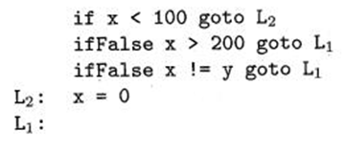
Control Flow
Boolean Expressions
Short-Circuit Code
EXAMPLE:
if ( x < 100 || x > 200 && x != y ) x = 0;

Slide 19
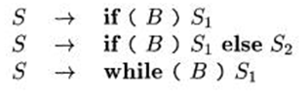
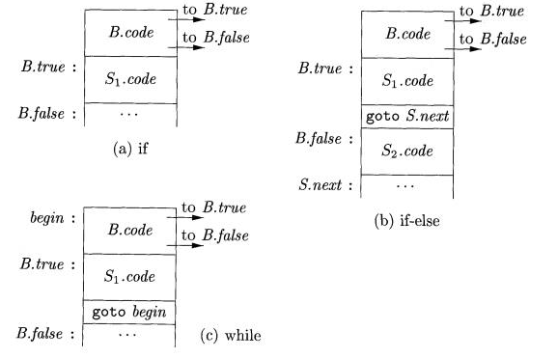
Control Flow
3. Flow-of-Control Statements

Slide 20
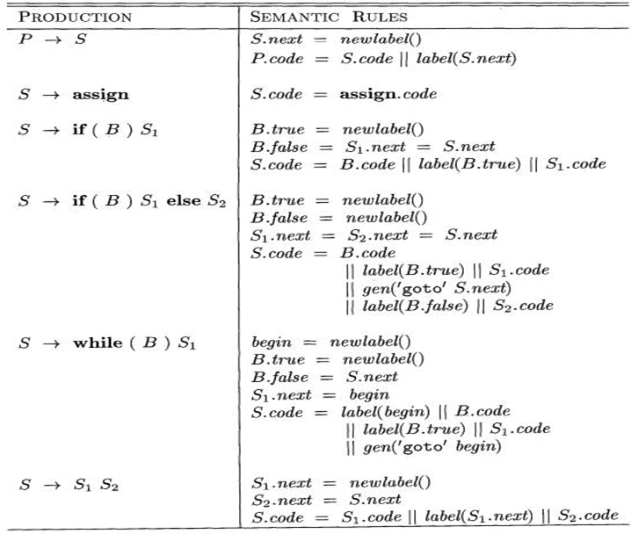

Slide 21
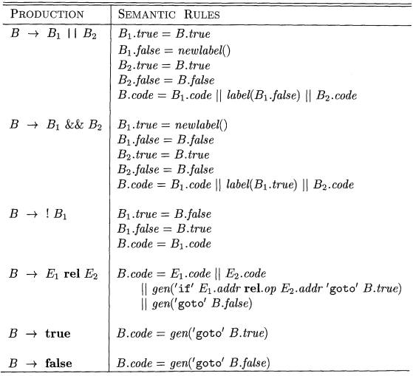
4. Control-Flow Translation of Boolean Expressions

Slide 22
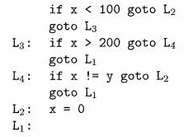
Example

Slide 23
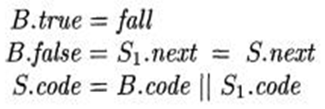

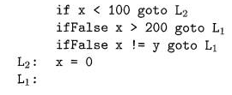
5. Avoiding Redundant Goto’s
This if False instruction takes advantage of the natural flow from one instruction to the next in sequence, so control simply "falls through" to label L₄ if x > 200 is false, thereby avoiding a jump .

Slide 24
Comparison of Goto statements

Slide 25
6. Boolean Values and Jumping Code
Boolean expressions alter the flow of control in statements. A Boolean expression may also be evaluated for its value, as in assignment statements such as x = true ; or x = a<b; .
A clean way of handling both roles of Boolean expressions is to first build a syntax tree for expressions, using either One pass or Two pass approach.
Two passes. Construct a complete syntax tree for the input, and then walk the tree in depth-first order, computing the translations specified by the semantic rules.

Slide 26

6. Boolean Values and Jumping Code
One pass for statements and two passes for expressions.
With this approach, we would translate E in while (E) Si before Si is examined. The translation of E, however, would be done by building its syntax tree and then walking the tree.

Slide 27
Backpatching
One-Pass Code Generation Using Backpatching
Backpatching can be used to generate code for Boolean expressions and flow-of-control statements in one pass.
For specificity, we generate instructions into an instruction array, and labels will be indices into this array. To manipulate lists of jumps, we use three functions:
1. makelist(i) creates a new list containing only i, an index into the array of instructions; makelist returns a pointer to the newly created list.
2. merge(p1,p2) concatenates the lists pointed to by p1 and p2, and returns a pointer to the concatenated list.
3. backpatch(p,i) inserts i as the target label for each of the instructions on the list pointed to by p.

Slide 28
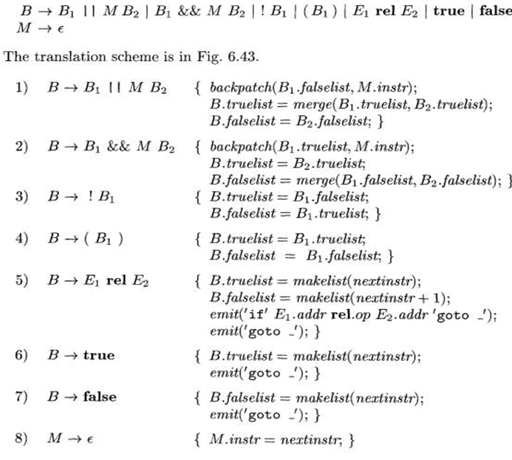
Backpatching for Boolean Expressions

Slide 29






Backpatching

Slide 30
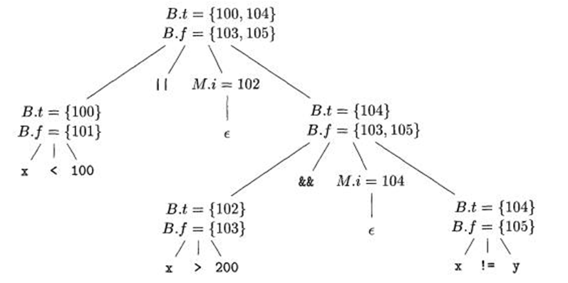
Backpatching

Slide 31

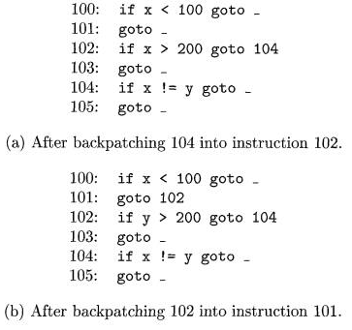
Flow of Control

Slide 32
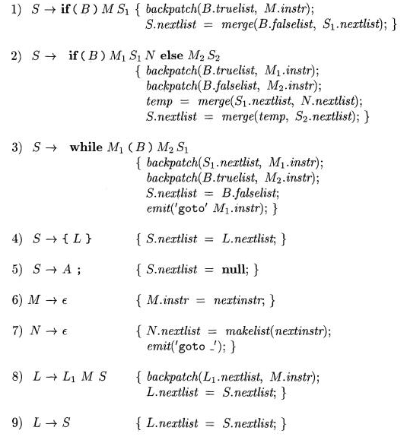

Slide 33
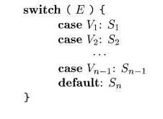
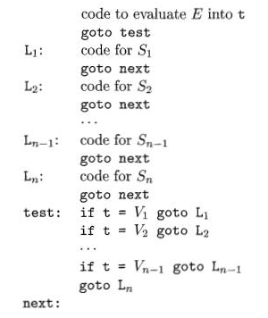
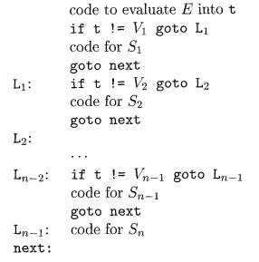
Switch-Statements

Slide 34
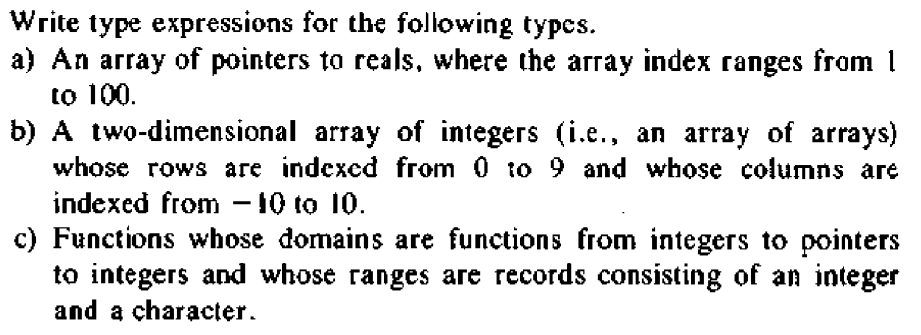

Slide 35
